Slide 1


Exploratory Data Analysis of crimes in Canada
From the year 2000 to 2020
Data source : Statistics Canada, table: 35-10-0177-01, released on 2021-07-27

Slide 2
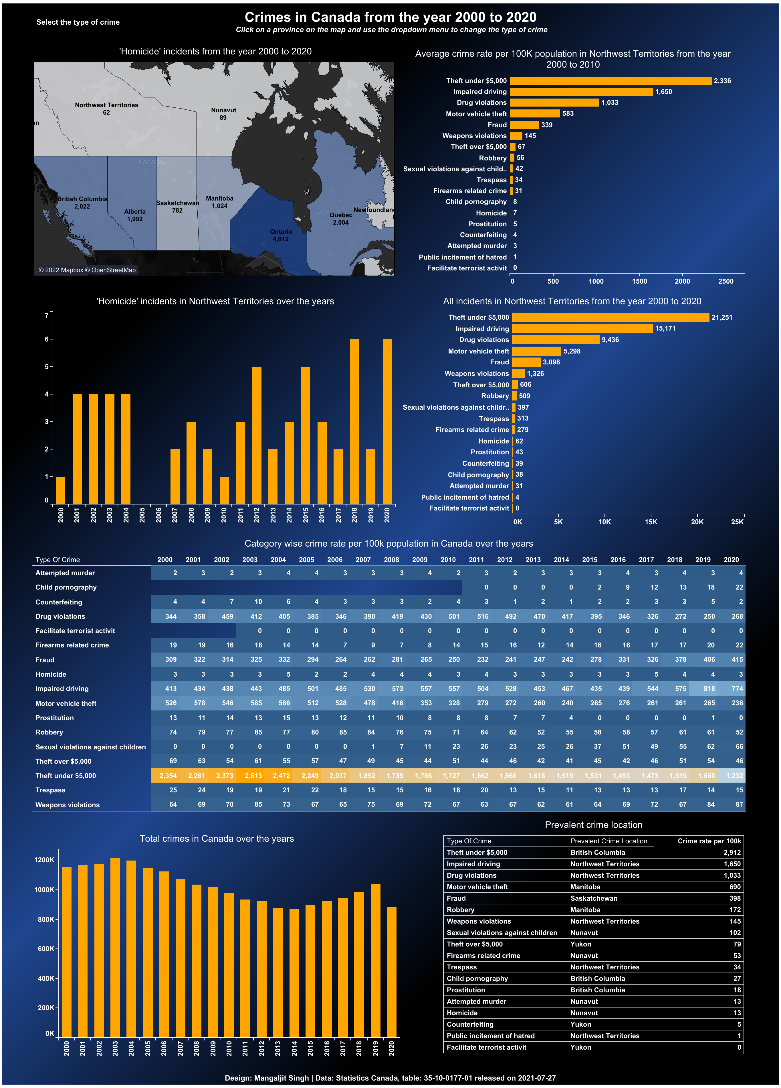
Introduction
In this project, the exploratory data analysis is performed on the incident-based crime data for Canada available at Statistics Canada (table: 35-10-0177-01, released on 2021-07-27).
For the analysis, pandas, seaborn and matplotlib library available with open-source Python programming were utilized.
Data analysis also involved cleaning the data to bring it into a useful format facilitating the data analysis.
A tableau dashboard was also prepared, and the dashboard is available on the following link. https://public.tableau.com/views/CrimesinCanadafrom2000-2020/Dashboard?:language=en-US&:display_count=n&:origin=viz_share_link
A snapshot of the tableau dashboard is shown below.
All the python codes are available at the link below:
Mangaljit/Crimes_in_Canada_2000_2020 (github.com)

Slide 3
Important findings of the data analysis.
Theft under $5000, motor vehicle theft, fraud, drug violations and impaired driving were the top 5 crimes in Canada over the year 2000 to 2020.
Northwest Territories, Yukon, Nunavut, Saskatchewan and British Columbia were the top 5 provinces with the highest crime rate (crimes per 100k population).
Ontario, Quebec, British Columbia, Alberta and Saskatchewan were the top 5 provinces with the highest number of crimes over the year 2000 to 2020.
British Columbia has the highest crime rate for crimes related to theft under $5000, child pornography and prostitution.
Northwest Territories is the province with the highest crime rate for impaired driving, drug violations, weapon violations, trespassing and public incitement of hatred.
Manitoba is the province with the highest crime rate for motor vehicle theft and robbery.
Nunavut is the province with the highest crime rate for Sexual violations against children, Firearms related crime, Attempted murder and homicide.
Yukon is the province with the highest crime rate for crimes related to Theft over $5000 and Counterfeiting.
Ontario, Quebec and British Columbia were the top 3 provinces with highest number drug violations crime.
Among all the provinces, Ontario was the top province with the highest number of crimes related to Theft under $5,000, Fraud, Motor vehicle theft, Drug violations, Impaired driving, Robbery, Theft over $5,000, weapon violations, sexual violations against children, prostitution, firearm related crimes, counterfeiting, attempted murder and homicide.

Slide 4
Important findings of the data analysis.
British Columbia was the top province with the highest number of trespass and child pornography related crimes.
Quebec was the top province with the highest number of crimes related of sexual violations against children and Public incitement of hatred.
Impaired driving, Fraud, Sexual violations against children, weapon violations and Child pornography were the top 5 crimes with a positive growth in crime rate from the year 2000 to 2020.
Theft under $5,000, Motor vehicle theft and Drug violations were the top 3 crimes with a negative growth in crime rate from the year 2000 to 2020.

Slide 5
A quick look at the data set
Year | Location | Crime | Incidents | Crime rate
2000 | Alberta | Attempted murder | 35 | 1.16
2000 | Alberta | Counterfeiting | 137 | 4.56
2000 | Alberta | Drug violations | 6979 | 232.25
2000 | Alberta | Firearms related crime | 203 | 6.76
2000 | Alberta | Fraud | 11800 | 392.69
... | ... | ... | ... | ...
2020 | Yukon | Sexual violations against children | 27 | 64.21
2020 | Yukon | Theft over $5,000 | 29 | 68.96
2020 | Yukon | Theft under $5,000 | 782 | 1859.6
2020 | Yukon | Trespass | 8 | 19.02
2020 | Yukon | Weapons violations | 62 | 147.44
The dataset contains a total of 4663 rows.

Slide 6
Category of crimes in the data set
There are a total of 18 unique category of crimes in the data set.
Crime
Attempted murder
Counterfeiting
Drug violations
Firearms related crime
Fraud
Homicide
Impaired driving
Motor vehicle theft
Prostitution
Robbery
Sexual violations against children
Theft over $5,000
Theft under $5,000
Trespass
Weapons violations
Facilitate terrorist activit
Public incitement of hatred
Child pornography

Slide 7
Category wise total number of crimes in Canada (2000 to 2020)
Crime | Incidents
Theft under $5,000 | 11808215
Motor vehicle theft | 2426849
Fraud | 2039657
Drug violations | 2003269
Impaired driving | 1666504
Robbery | 584867
Theft over $5,000 | 367422
Weapons violations | 318966
Sexual violations against children | 75836
Trespass | 68410
Prostitution | 62989
Firearms related crime | 47437
Child pornography | 26238
Counterfeiting | 24386
Attempted murder | 15730
Homicide | 12641
Public incitement of hatred | 755
Facilitate terrorist activities | 102

Slide 8
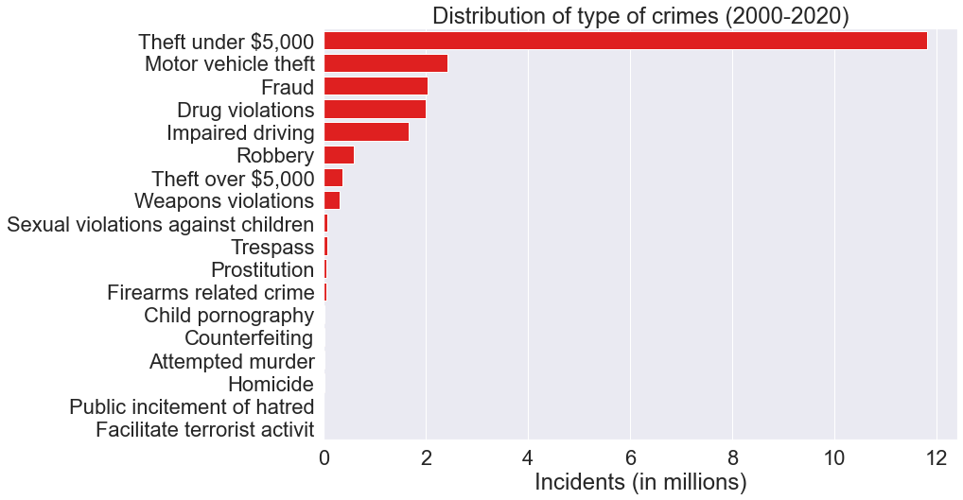
Category wise total number of crimes in Canada (2000-2020)

Slide 9
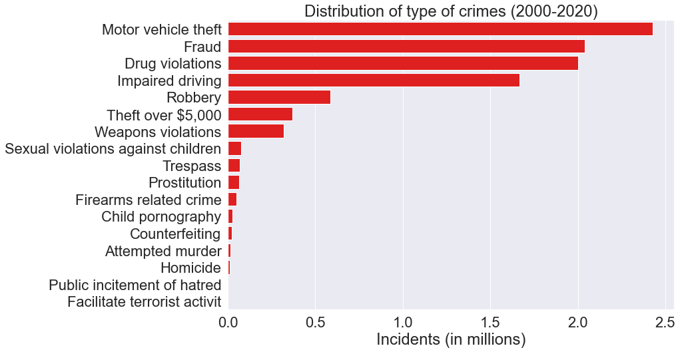
Category wise total number of crimes in Canada (2000-2020)
(Category ‘Theft under $5,000’ excluded)

Slide 10
Category wise crime rate per 100k population in Canada (2000-2020)
Crime | Crime rate
Theft under $5,000 | 1849.00
Impaired driving | 521.52
Drug violations | 390.48
Motor vehicle theft | 383.44
Fraud | 300.7
Weapons violations | 70.02
Robbery | 68.77
Theft over $5,000 | 50.11
Sexual violations against children | 22.03
Trespass | 16.95
Firearms related crime | 14.76
Child pornography | 7.49
Prostitution | 7.39
Counterfeiting | 3.46
Homicide | 3.37
Attempted murder | 3.06
Public incitement of hatred | 0.17
Facilitate terrorist activities | 0.02

Slide 11
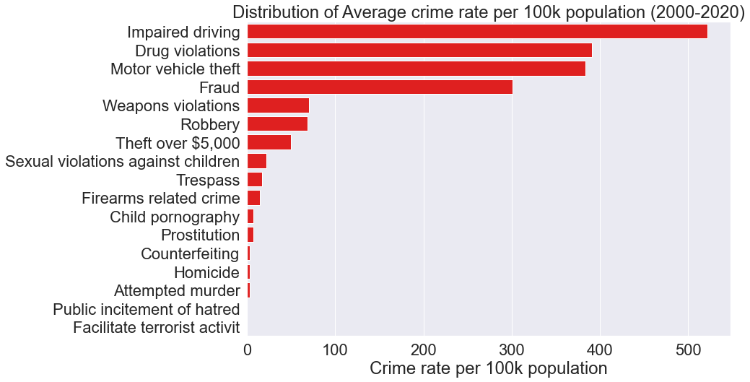
Category wise crime rate per 100k population in Canada (2000-2020)

Slide 12
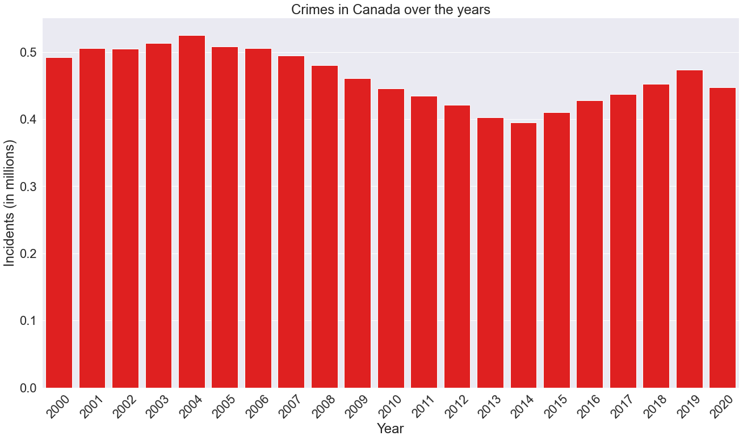
Total crimes in Canada over the years
Year | Incidents
2000 | 492644
2001 | 505836
2002 | 505004
2003 | 513320
2004 | 524985
2005 | 508032
2006 | 505660
2007 | 494455
2008 | 480347
2009 | 461086
2010 | 445842
2011 | 435098
2012 | 420928
2013 | 402833
2014 | 395324
2015 | 410648
2016 | 428178
2017 | 437490
2018 | 452924
2019 | 474016
2020 | 447408

Slide 13
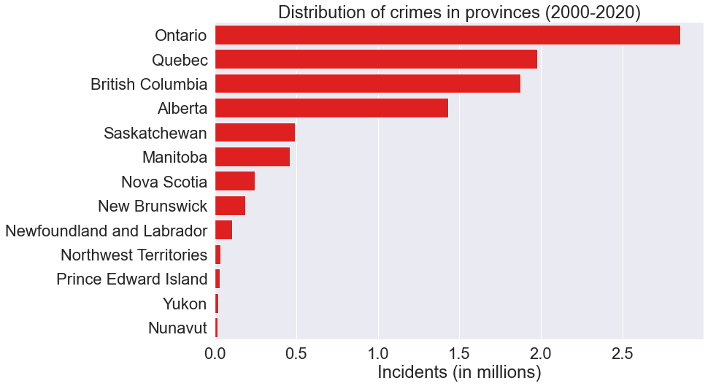
Total number of crimes in provinces (2000-2020)
Location | Incidents
Ontario | 2854020
Quebec | 1978474
British Columbia | 1875612
Alberta | 1433195
Saskatchewan | 491842
Manitoba | 458827
Nova Scotia | 246516
New Brunswick | 188103
Newfoundland and Labrador | 105239
Northwest Territories | 36650
Prince Edward Island | 33120
Yukon | 21650
Nunavut | 18810

Slide 14
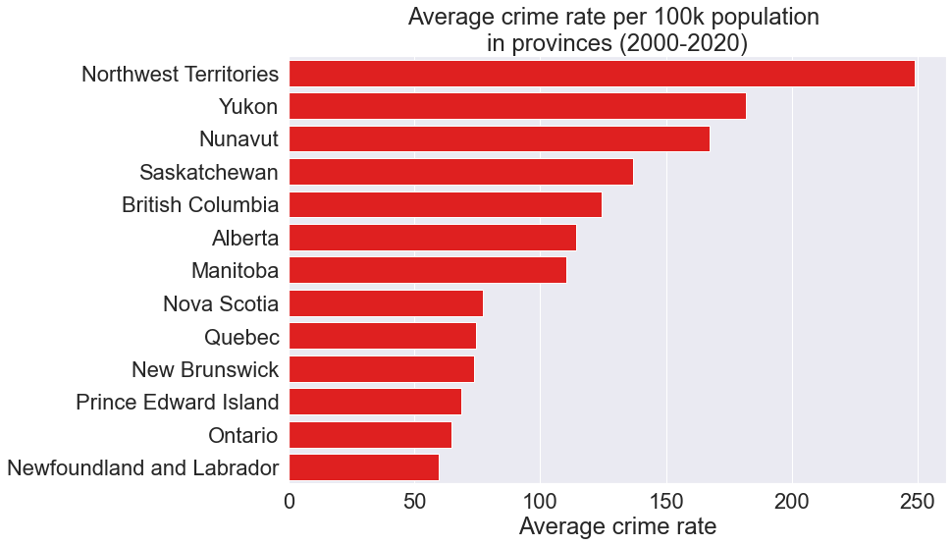
Average crime rate per 100k population in provinces (2000-2020)
Location | Crime rate
Northwest Territories | 248.82
Yukon | 181.96
Nunavut | 167.43
Saskatchewan | 136.83
British Columbia | 124.58
Alberta | 114.2
Manitoba | 110.44
Nova Scotia | 77.34
Quebec | 74.68
New Brunswick | 73.56
Prince Edward Island | 68.54
Ontario | 64.78
Newfoundland and Labrador | 59.83

Slide 15
Table summarizing total crimes in provinces (2000-2020)
Year | 2000 | 2001 | 2002 | 2003 | 2004 | 2005 | 2006 | 2007 | 2008 | 2009 | 2010 | 2011 | 2012 | 2013 | 2014 | 2015 | 2016 | 2017 | 2018 | 2019 | 2020
location
Alberta | 53348 | 58203 | 59368 | 64024 | 65149 | 65878 | 66555 | 69544 | 72185 | 68545 | 65097 | 60939 | 60669 | 63327 | 66732 | 76072 | 77883 | 80305 | 82387 | 84662 | 72323
British Columbia | 85668 | 93837 | 97428 | 107110 | 111384 | 106342 | 100722 | 100470 | 93154 | 89780 | 86327 | 84263 | 77200 | 75281 | 76568 | 76492 | 78026 | 76538 | 78895 | 92605 | 87522
Manitoba | 24085 | 26016 | 24395 | 25116 | 28116 | 26167 | 28216 | 26872 | 21213 | 20229 | 18937 | 17607 | 16954 | 16094 | 15670 | 16560 | 18421 | 19582 | 21073 | 24031 | 23473
New Brunswick | 10459 | 10461 | 10179 | 10033 | 10472 | 9083 | 8045 | 8246 | 8794 | 8482 | 8575 | 8099 | 7952 | 7432 | 6807 | 7371 | 7297 | 8952 | 9865 | 10273 | 11226
Newfoundland and Labrador | 4595 | 4525 | 4178 | 4043 | 4583 | 4261 | 3864 | 4515 | 4771 | 5135 | 6222 | 5850 | 5498 | 5636 | 5115 | 4847 | 5194 | 5092 | 5141 | 6187 | 5987
Northwest Territories | 1014 | 1238 | 1444 | 1661 | 1771 | 1905 | 1716 | 1754 | 2054 | 1760 | 2066 | 1848 | 1759 | 1462 | 1504 | 1625 | 1598 | 1884 | 1904 | 2395 | 2288
Nova Scotia | 12275 | 12152 | 11676 | 12181 | 13734 | 12507 | 12234 | 11505 | 11686 | 11543 | 12062 | 11785 | 11230 | 11143 | 11260 | 10444 | 10482 | 11635 | 11685 | 11447 | 11850
Nunavut | 697 | 806 | 765 | 863 | 847 | 809 | 811 | 848 | 866 | 942 | 958 | 910 | 1108 | 952 | 751 | 794 | 857 | 901 | 925 | 1169 | 1231
Ontario | 159184 | 157110 | 156118 | 147681 | 148428 | 147744 | 150726 | 144147 | 142752 | 136146 | 129811 | 126554 | 123010 | 113746 | 110155 | 114190 | 120462 | 125151 | 133374 | 135122 | 132409
Prince Edward Island | 1577 | 1631 | 1726 | 1742 | 1649 | 1480 | 1397 | 1340 | 1288 | 1477 | 1639 | 1760 | 1620 | 1441 | 1296 | 1191 | 1635 | 1348 | 1690 | 2157 | 2036
Quebec | 115050 | 114270 | 112916 | 113461 | 113287 | 108679 | 109985 | 103780 | 99801 | 95209 | 90918 | 90226 | 88041 | 81820 | 76820 | 76896 | 79422 | 80294 | 79717 | 77345 | 70537
Saskatchewan | 23724 | 24648 | 23630 | 24367 | 24661 | 22438 | 20726 | 20510 | 20808 | 20887 | 22271 | 24450 | 24984 | 23506 | 21547 | 23118 | 25920 | 24711 | 25133 | 24978 | 24825
Yukon | 968 | 939 | 1181 | 1038 | 904 | 739 | 663 | 924 | 975 | 951 | 959 | 807 | 903 | 993 | 1099 | 1048 | 981 | 1097 | 1135 | 1645 | 1701

Slide 16
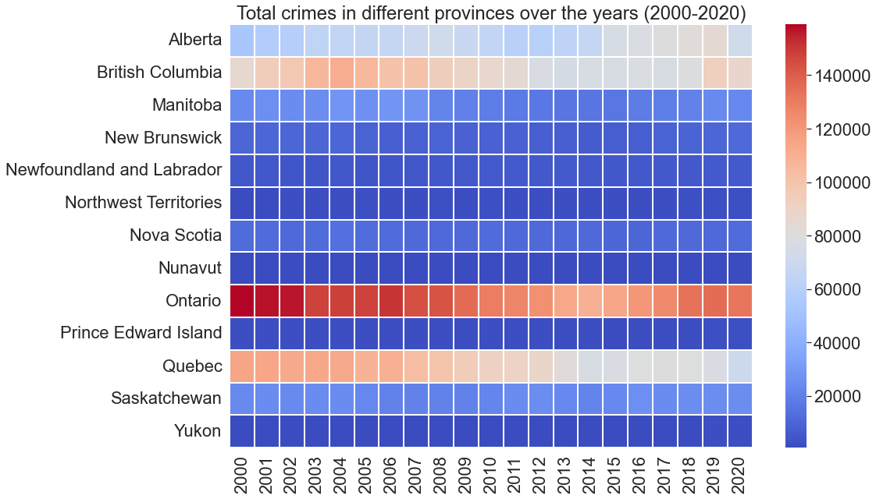
Heatmap of total crimes in different provinces (2000-2020)

Slide 17
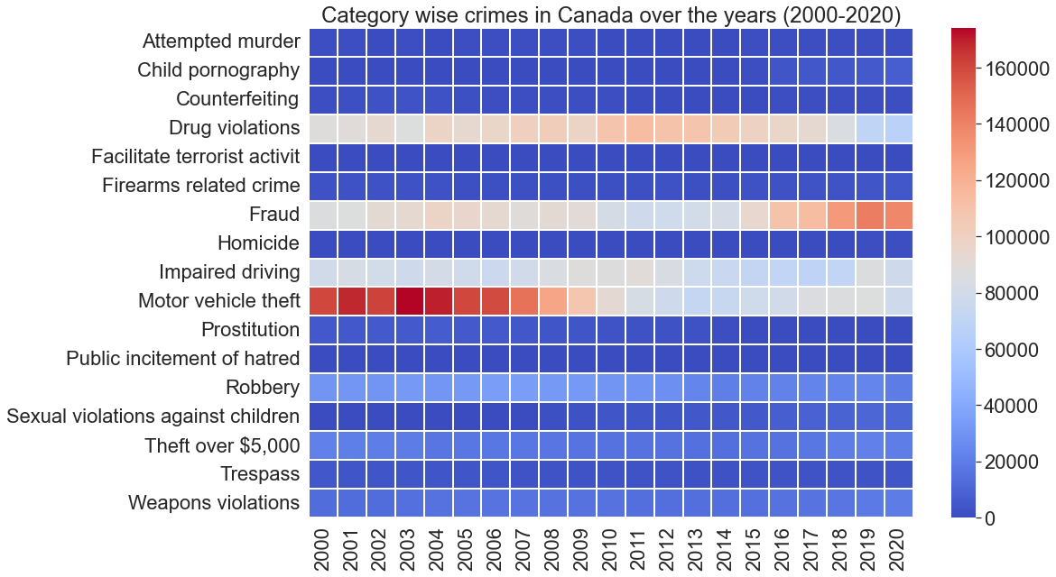
Heatmap of total category wise crimes in Canada (2000-2020)

Slide 18
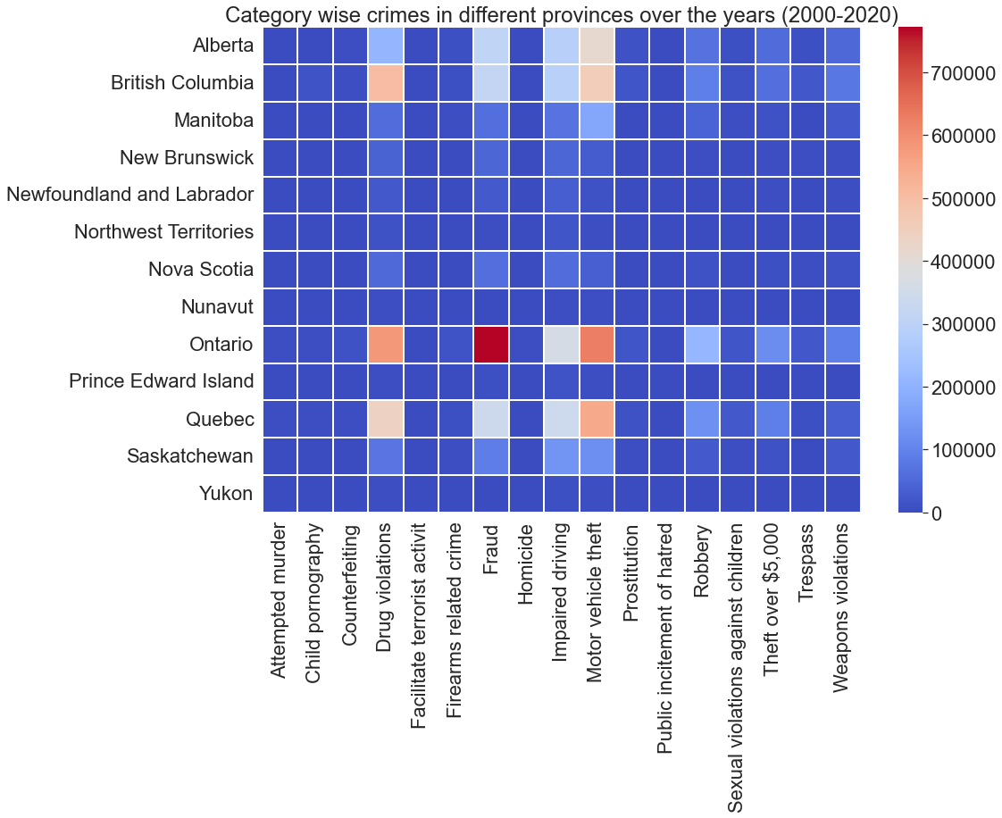
Heatmap of category wise crimes in different provinces (2000-2020)

Slide 19
Table summarizing average crime rate per 100k population in provinces (2000-2020)
Year | 2000 | 2001 | 2002 | 2003 | 2004 | 2005 | 2006 | 2007 | 2008 | 2009 | 2010 | 2011 | 2012 | 2013 | 2014 | 2015 | 2016 | 2017 | 2018 | 2019 | 2020
Location
Alberta | 126.81 | 135.95 | 135.55 | 134.08 | 134.07 | 123.94 | 121.58 | 123.69 | 125.47 | 116.44 | 109 | 94.61 | 92.11 | 93.57 | 96.12 | 107.97 | 109.18 | 111.38 | 112.75 | 114.18 | 96.21
British Columbia | 151.49 | 164.43 | 169.81 | 173.22 | 178.71 | 158.37 | 148.41 | 146.34 | 133.86 | 127.22 | 120.81 | 110.1 | 99.44 | 95.64 | 95.68 | 94.2 | 94.45 | 91.33 | 92.62 | 107 | 100.01
Manitoba | 149.94 | 161.39 | 150.66 | 143.87 | 159.72 | 138.8 | 149 | 141.21 | 110.69 | 104.61 | 96.94 | 83.95 | 79.79 | 74.86 | 72.07 | 75.38 | 82.46 | 86.3 | 91.63 | 103.22 | 100.11
New Brunswick | 99.54 | 99.66 | 97.03 | 89.26 | 93.16 | 75.9 | 67.44 | 69.14 | 73.59 | 70.69 | 71.17 | 63.04 | 61.68 | 57.63 | 52.76 | 57.14 | 56.23 | 68.69 | 75.33 | 77.79 | 84.5
Newfoundland and Labrador | 62.16 | 61.92 | 57.44 | 51.98 | 59.05 | 55.23 | 47.3 | 55.44 | 58.29 | 62.11 | 74.5 | 65.55 | 61.44 | 62.89 | 56.97 | 53.99 | 57.71 | 56.7 | 57.54 | 69.52 | 67.46
Northwest Territories | 178.84 | 216.5 | 247.55 | 260.18 | 272.67 | 274.34 | 248.39 | 252.74 | 296.14 | 254.93 | 298.36 | 249.88 | 237.06 | 196.33 | 201.6 | 216.08 | 210.53 | 246.87 | 248.99 | 312.88 | 298.02
Nova Scotia | 93.89 | 93.09 | 89.2 | 86.62 | 97.47 | 83.34 | 81.53 | 76.9 | 78.04 | 76.9 | 80.02 | 73.42 | 70.01 | 69.7 | 70.57 | 65.6 | 65.4 | 72.04 | 71.72 | 69.44 | 71.18
Nunavut | 194.97 | 204.63 | 189.61 | 196.23 | 189.14 | 166.72 | 164.51 | 168.82 | 169.71 | 180.6 | 179.52 | 156.56 | 187.98 | 158.47 | 122.81 | 128 | 136.34 | 141.16 | 142.65 | 178.08 | 184.01
Ontario | 97.3 | 94.33 | 92.23 | 80.42 | 79.86 | 73.7 | 74.4 | 70.58 | 69.26 | 65.47 | 61.77 | 56.14 | 54.04 | 49.52 | 47.58 | 49 | 51.07 | 52.32 | 54.83 | 54.65 | 52.86
Prince Edward Island | 82.53 | 85.25 | 90.07 | 84.63 | 79.85 | 71.47 | 63.33 | 60.81 | 58.01 | 65.98 | 72.3 | 71.91 | 65.93 | 58.83 | 52.84 | 48.47 | 65.44 | 52.72 | 64.81 | 80.68 | 75.03
Quebec | 111.7 | 110.35 | 108.39 | 101.04 | 100.22 | 89.59 | 90.07 | 84.32 | 80.37 | 75.87 | 71.66 | 66.3 | 64.25 | 59.34 | 55.44 | 55.33 | 56.79 | 56.89 | 55.81 | 53.52 | 48.39
Saskatchewan | 168.15 | 176.02 | 169.33 | 163.02 | 164.83 | 141.14 | 130.54 | 127.93 | 127.83 | 126.16 | 132.39 | 134.92 | 135.61 | 125.73 | 113.88 | 121.31 | 134.22 | 126.36 | 127.26 | 125.33 | 123.89
Yukon | 227.29 | 222.42 | 277.87 | 223.49 | 191.49 | 144.77 | 128.41 | 177.38 | 184.17 | 176.2 | 173.25 | 134.06 | 146.6 | 159.94 | 174.08 | 163.56 | 149.7 | 162.67 | 164.39 | 233.3 | 237.94

Slide 20
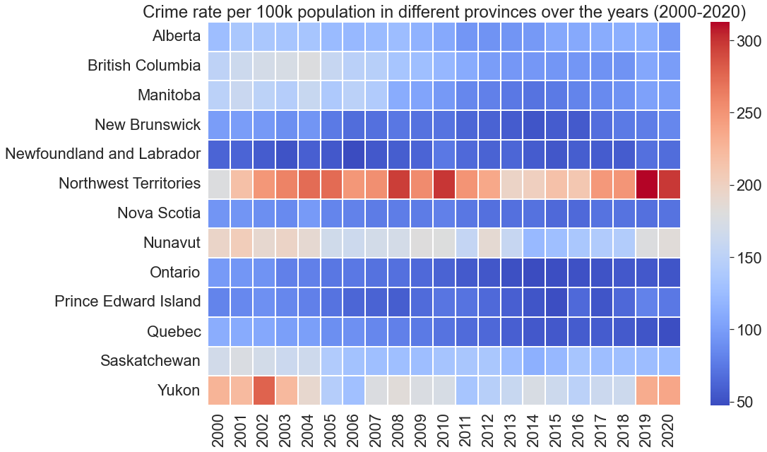
Heatmap of average crimes rate per 100k population in provinces over the years

Slide 21
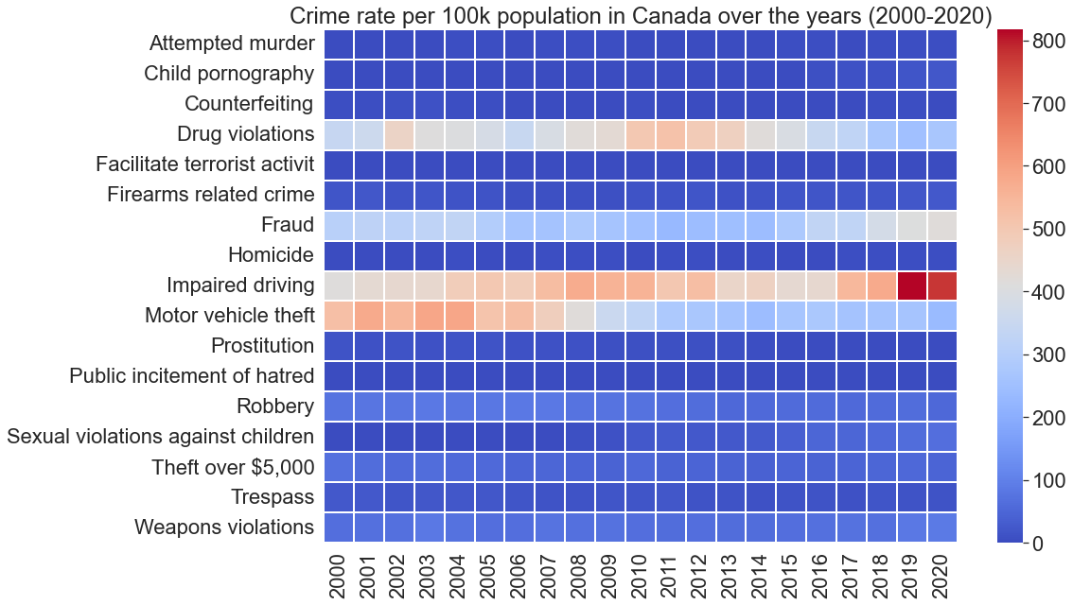
Heatmap of category wise average crimes rate per 100k population in Canada over the years

Slide 22
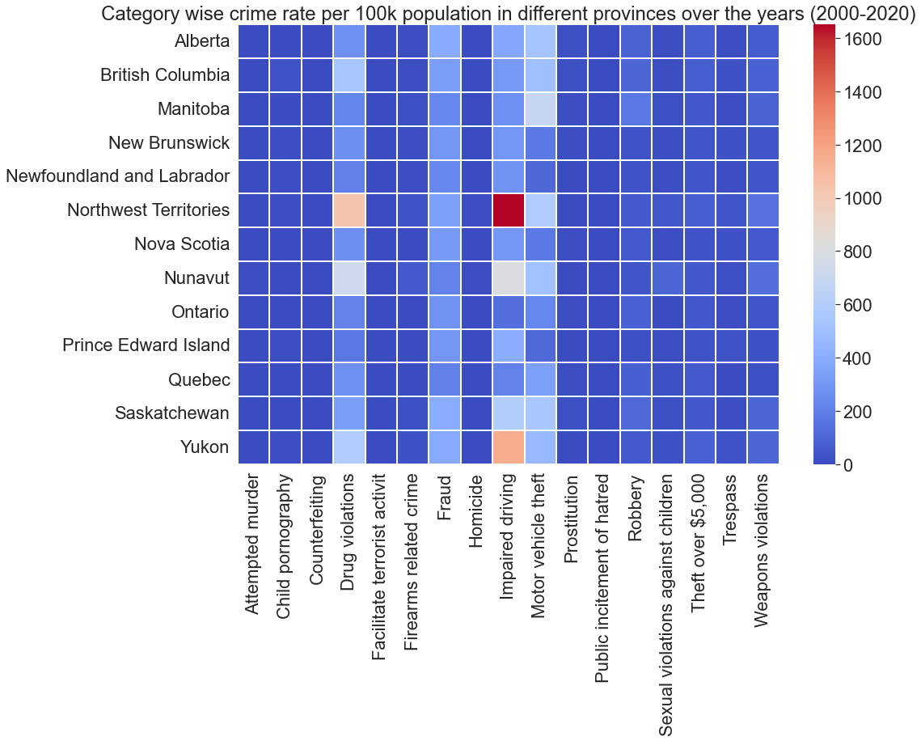
Heatmap of average crimes rate in different categories per 100k population (2000-2020)

Slide 23
Category wise prevalent crime location (2000-2020)
Crime | Prevalent crime location | Incidents
Theft under $5,000 | Ontario | 3836347
Fraud | Ontario | 771548
Motor vehicle theft | Ontario | 624191
Drug violations | Ontario | 580226
Impaired driving | Ontario | 364440
Robbery | Ontario | 212098
Theft over $5,000 | Ontario | 117830
Weapons violations | Ontario | 92912
Sexual violations against children | Quebec | 22652
Trespass | British Columbia | 20790
Prostitution | Ontario | 17196
Firearms related crime | Ontario | 14148
Child pornography | British Columbia | 13508
Counterfeiting | Ontario | 9670
Attempted murder | Ontario | 5566
Homicide | Ontario | 4012
Public incitement of hatred | Quebec | 319
Facilitate terrorist activit | Ontario | 45
Crime | Prevalent crime location | Crime rate
Theft under $5,000 | British Columbia | 2912.43
Impaired driving | Northwest Territories | 1650.29
Drug violations | Northwest Territories | 1033.13
Motor vehicle theft | Manitoba | 690.05
Fraud | Saskatchewan | 398.33
Robbery | Manitoba | 172.02
Weapons violations | Northwest Territories | 145.21
Sexual violations against children | Nunavut | 101.97
Theft over $5,000 | Yukon | 78.91
Firearms related crime | Nunavut | 53.2
Trespass | Northwest Territories | 34.47
Child pornography | British Columbia | 26.94
Prostitution | British Columbia | 18.05
Attempted murder | Nunavut | 12.7
Homicide | Nunavut | 12.6
Counterfeiting | Yukon | 4.52
Public incitement of hatred | Northwest Territories | 0.56
Facilitate terrorist activities | Yukon | 0.15

Slide 24
Province wise most prevalent crime category (2000-2020)
Location | Most prevalent crime | Incidents
Ontario | Theft under $5,000 | 3836347
British Columbia | Theft under $5,000 | 2714237
Quebec | Theft under $5,000 | 1847647
Alberta | Theft under $5,000 | 1676906
Manitoba | Theft under $5,000 | 497927
Saskatchewan | Theft under $5,000 | 479929
Nova Scotia | Theft under $5,000 | 319470
New Brunswick | Theft under $5,000 | 204377
Newfoundland and Labrador | Theft under $5,000 | 127024
Prince Edward Island | Theft under $5,000 | 53925
Northwest Territories | Theft under $5,000 | 21251
Yukon | Theft under $5,000 | 20183
Nunavut | Theft under $5,000 | 8992
Location | Crime | Crime rate
British Columbia | Theft under $5,000 | 2912.43
Yukon | Theft under $5,000 | 2790.01
Northwest Territories | Theft under $5,000 | 2336.22
Saskatchewan | Theft under $5,000 | 2170.65
Alberta | Theft under $5,000 | 2168.55
Manitoba | Theft under $5,000 | 1929.74
Prince Edward Island | Theft under $5,000 | 1808.33
Nova Scotia | Theft under $5,000 | 1615.47
Ontario | Theft under $5,000 | 1401.88
Nunavut | Theft under $5,000 | 1326.45
New Brunswick | Theft under $5,000 | 1288.81
Newfoundland and Labrador | Theft under $5,000 | 1160.34
Quebec | Theft under $5,000 | 1128.17

Slide 25
Province wise most prevalent crime category (2000-2020)
‘Theft under $5,000’ crime is ignored because of its high prevalence in all the provinces.
Location | Crime | Incidents
Ontario | Fraud | 771548
Quebec | Motor vehicle theft | 545783
British Columbia | Drug violations | 503764
Alberta | Motor vehicle theft | 413370
Manitoba | Motor vehicle theft | 174680
Saskatchewan | Impaired driving | 133380
Nova Scotia | Fraud | 61647
New Brunswick | Fraud | 47110
Newfoundland and Labrador | Impaired driving | 30855
Northwest Territories | Impaired driving | 15171
Prince Edward Island | Impaired driving | 12230
Yukon | Impaired driving | 8691
Nunavut | Impaired driving | 5855
Location | Crime | Crime rate
Northwest Territories | Impaired driving | 1650.29
Yukon | Impaired driving | 1157.28
Nunavut | Impaired driving | 807.04
Manitoba | Motor vehicle theft | 690.05
Saskatchewan | Impaired driving | 596.66
British Columbia | Drug violations | 537.74
Alberta | Motor vehicle theft | 533.35
Prince Edward Island | Impaired driving | 405.39
Quebec | Motor vehicle theft | 335.78
Nova Scotia | Fraud | 310.55
New Brunswick | Fraud | 295.83
Newfoundland and Labrador | Impaired driving | 281.51
Ontario | Fraud | 277.88

Slide 26
Canada
Crime | Total incidents (2000-2020) | Incidents in year 2000 | Incidents in year 2020 | Crime rate in 2000 | Crime rate in 2020 | Change in crime rate from the year 2000 to 2020
Impaired driving | 1666504 | 79225 | 77603 | 412.78 | 773.78 | 361
Fraud | 2039657 | 85791 | 138011 | 309.44 | 415.37 | 105.93
Sexual violations against children | 75836 | 0 | 10388 | 0 | 66.27 | 66.27
Weapons violations | 318966 | 13003 | 19485 | 63.93 | 86.78 | 22.85
Child pornography | 26238 | 0 | 7215 | 0 | 21.54 | 21.54
Firearms related crime | 47437 | 2236 | 4137 | 18.5 | 22.39 | 3.89
Attempted murder | 15730 | 767 | 864 | 1.69 | 3.62 | 1.93
Homicide | 12641 | 546 | 743 | 2.99 | 3.45 | 0.46
Public incitement of hatred | 755 | 0 | 112 | 0 | 0.38 | 0.38
Facilitate terrorist activit | 102 | 0 | 4 | 0 | 0 | 0
Counterfeiting | 24386 | 1360 | 831 | 4.44 | 2.33 | -2.11
Trespass | 68410 | 4323 | 3427 | 25.41 | 14.62 | -10.79
Prostitution | 62989 | 5051 | 66 | 12.91 | 0.14 | -12.77
Robbery | 584867 | 30582 | 19268 | 73.88 | 51.77 | -22.12
Theft over $5,000 | 367422 | 21354 | 20272 | 68.94 | 46.2 | -22.74
Drug violations | 2003269 | 88091 | 66827 | 343.59 | 268.44 | -75.15
Motor vehicle theft | 2426849 | 160315 | 78155 | 526.3 | 236.24 | -290.06
Theft under $5,000 | 11808215 | 663040 | 434425 | 2354.01 | 1231.51 | -1122.49

Slide 27
Alberta
Crime | Total incidents (2000-2020) | Incidents in year 2000 | Incidents in year 2020 | Crime rate in 2000 | Crime rate in 2020 | Change in crime rate from the year 2000 to 2020
Fraud | 308383 | 11800 | 20240 | 392.69 | 457.72 | 65.03
Theft over $5,000 | 55114 | 1847 | 4140 | 61.47 | 93.63 | 32.16
Sexual violations against children | 8808 | 0 | 1356 | 0 | 30.67 | 30.67
Weapons violations | 48644 | 1415 | 3164 | 47.09 | 71.55 | 24.46
Firearms related crime | 7365 | 203 | 752 | 6.76 | 17.01 | 10.25
Child pornography | 1744 | 0 | 252 | 0 | 5.7 | 5.7
Homicide | 1992 | 59 | 139 | 1.96 | 3.14 | 1.18
Public incitement of hatred | 83 | 0 | 14 | 0 | 0.32 | 0.32
Attempted murder | 1121 | 35 | 56 | 1.16 | 1.27 | 0.11
Facilitate terrorist activit | 19 | 0 | 0 | 0 | 0 | 0
Counterfeiting | 3094 | 137 | 132 | 4.56 | 2.99 | -1.57
Trespass | 8286 | 415 | 502 | 13.81 | 11.35 | -2.46
Prostitution | 9425 | 778 | 9 | 25.89 | 0.2 | -25.69
Robbery | 68104 | 2862 | 2926 | 95.24 | 66.17 | -29.07
Drug violations | 209108 | 6979 | 7896 | 232.25 | 178.57 | -53.68
Motor vehicle theft | 413370 | 14916 | 19215 | 496.38 | 434.54 | -61.84
Impaired driving | 288535 | 11902 | 11530 | 396.08 | 260.75 | -135.33
Theft under $5,000 | 1676906 | 73879 | 81404 | 2458.58 | 1840.94 | -617.64

Slide 28
British Columbia
Crime | Total incidents (2000-2020) | Incidents in year 2000 | Incidents in year 2020 | Crime rate in 2000 | Crime rate in 2020 | Change in crime rate from the year 2000 to 2020
Fraud | 318395 | 11764 | 20947 | 291.25 | 406.92 | 115.67
Child pornography | 13508 | 0 | 4185 | 0 | 81.3 | 81.3
Impaired driving | 290239 | 9362 | 15776 | 231.78 | 306.47 | 74.69
Theft over $5,000 | 62642 | 2252 | 5351 | 55.75 | 103.95 | 48.2
Sexual violations against children | 11176 | 0 | 1374 | 0 | 26.69 | 26.69
Weapons violations | 77279 | 2838 | 4637 | 70.26 | 90.08 | 19.82
Public incitement of hatred | 125 | 0 | 24 | 0 | 0.47 | 0.47
Facilitate terrorist activit | 22 | 0 | 2 | 0 | 0.04 | 0.04
Homicide | 2022 | 85 | 98 | 2.1 | 1.9 | -0.2
Attempted murder | 2080 | 91 | 102 | 2.25 | 1.98 | -0.27
Firearms related crime | 6915 | 368 | 385 | 9.11 | 7.48 | -1.63
Counterfeiting | 3321 | 188 | 117 | 4.65 | 2.27 | -2.38
Trespass | 20790 | 1052 | 1007 | 26.04 | 19.56 | -6.48
Prostitution | 16041 | 974 | 14 | 24.11 | 0.27 | -23.84
Robbery | 90500 | 5500 | 2674 | 136.17 | 51.95 | -84.22
Drug violations | 503764 | 21924 | 20470 | 542.78 | 397.65 | -145.13
Motor vehicle theft | 456793 | 29270 | 10359 | 724.65 | 201.24 | -523.41
Theft under $5,000 | 2714237 | 158835 | 97700 | 3932.34 | 1897.93 | -2034.41

Slide 29
Manitoba
Crime | Total incidents (2000-2020) | Incidents in year 2000 | Incidents in year 2020 | Crime rate in 2000 | Crime rate in 2020 | Change in crime rate from the year 2000 to 2020
Fraud | 62379 | 2473 | 5610 | 215.54 | 406.74 | 191.2
Sexual violations against children | 4180 | 0 | 704 | 0 | 51.04 | 51.04
Weapons violations | 23388 | 895 | 1777 | 78 | 128.84 | 50.84
Impaired driving | 70420 | 3431 | 4669 | 299.03 | 338.51 | 39.48
Child pornography | 763 | 0 | 309 | 0 | 22.4 | 22.4
Firearms related crime | 3852 | 160 | 280 | 13.94 | 20.3 | 6.36
Homicide | 1024 | 30 | 62 | 2.61 | 4.5 | 1.89
Public incitement of hatred | 21 | 0 | 5 | 0 | 0.36 | 0.36
Facilitate terrorist activit | 2 | 0 | 0 | 0 | 0 | 0
Attempted murder | 592 | 21 | 19 | 1.83 | 1.38 | -0.45
Counterfeiting | 609 | 45 | 20 | 3.92 | 1.45 | -2.47
Drug violations | 57667 | 2099 | 2466 | 182.94 | 178.79 | -4.15
Theft over $5,000 | 10310 | 497 | 467 | 43.32 | 33.86 | -9.46
Robbery | 44735 | 2090 | 2240 | 182.16 | 162.41 | -19.75
Trespass | 1807 | 265 | 41 | 23.1 | 2.97 | -20.13
Prostitution | 2398 | 273 | 2 | 23.79 | 0.15 | -23.64
Motor vehicle theft | 174680 | 11806 | 4802 | 1028.96 | 348.16 | -680.8
Theft under $5,000 | 497927 | 27163 | 22176 | 2367.41 | 1607.82 | -759.59

Slide 30
New Brunswick
Crime | Total incidents (2000-2020) | Incidents in year 2000 | Incidents in year 2020 | Crime rate in 2000 | Crime rate in 2020 | Change in crime rate from the year 2000 to 2020
Fraud | 47110 | 2598 | 3984 | 346.16 | 509.8 | 163.64
Child pornography | 672 | 0 | 217 | 0 | 27.77 | 27.77
Sexual violations against children | 1956 | 0 | 213 | 0 | 27.26 | 27.26
Weapons violations | 5467 | 296 | 399 | 39.44 | 51.06 | 11.62
Firearms related crime | 1211 | 69 | 95 | 9.19 | 12.16 | 2.97
Counterfeiting | 597 | 26 | 41 | 3.46 | 5.25 | 1.79
Attempted murder | 191 | 3 | 10 | 0.4 | 1.28 | 0.88
Homicide | 197 | 10 | 14 | 1.33 | 1.79 | 0.46
Public incitement of hatred | 12 | 0 | 0 | 0 | 0 | 0
Facilitate terrorist activit | 1 | 0 | 0 | 0 | 0 | 0
Trespass | 3763 | 189 | 155 | 25.18 | 19.83 | -5.35
Prostitution | 1157 | 44 | 1 | 5.86 | 0.13 | -5.73
Robbery | 4122 | 188 | 134 | 25.05 | 17.15 | -7.9
Theft over $5,000 | 5934 | 378 | 315 | 50.37 | 40.31 | -10.06
Impaired driving | 46477 | 2612 | 2618 | 348.03 | 335.01 | -13.02
Motor vehicle theft | 28309 | 1648 | 1501 | 219.58 | 192.07 | -27.51
Drug violations | 40927 | 2398 | 1529 | 319.51 | 195.66 | -123.85
Theft under $5,000 | 204377 | 11758 | 6646 | 1566.65 | 850.44 | -716.21

Slide 31
Newfoundland and Labrador
Crime | Total incidents (2000-2020) | Incidents in year 2000 | Incidents in year 2020 | Crime rate in 2000 | Crime rate in 2020 | Change in crime rate from the year 2000 to 2020
Impaired driving | 30855 | 1140 | 2268 | 215.89 | 434.4 | 218.51
Fraud | 25645 | 1301 | 1478 | 246.38 | 283.09 | 36.71
Sexual violations against children | 1283 | 0 | 148 | 0 | 28.35 | 28.35
Child pornography | 408 | 0 | 105 | 0 | 20.11 | 20.11
Robbery | 2946 | 57 | 127 | 10.79 | 24.32 | 13.53
Weapons violations | 3794 | 133 | 199 | 25.19 | 38.12 | 12.93
Theft over $5,000 | 3729 | 135 | 167 | 25.57 | 31.99 | 6.42
Firearms related crime | 801 | 46 | 49 | 8.71 | 9.39 | 0.68
Facilitate terrorist activit | 0 | 0 | 0 | 0 | 0 | 0
Public incitement of hatred | 3 | 0 | 0 | 0 | 0 | 0
Homicide | 88 | 6 | 4 | 1.14 | 0.77 | -0.37
Prostitution | 165 | 3 | 0 | 0.57 | 0 | -0.57
Attempted murder | 76 | 9 | 1 | 1.7 | 0.19 | -1.51
Counterfeiting | 136 | 9 | 0 | 1.7 | 0 | -1.7
Drug violations | 22321 | 990 | 910 | 187.48 | 174.3 | -13.18
Trespass | 1020 | 121 | 43 | 22.91 | 8.24 | -14.67
Motor vehicle theft | 11969 | 645 | 488 | 122.15 | 93.47 | -28.68
Theft under $5,000 | 127024 | 7218 | 3519 | 1366.93 | 674 | -692.93

Slide 32
Northwest Territories
Crime | Total incidents (2000-2020) | Incidents in year 2000 | Incidents in year 2020 | Crime rate in 2000 | Crime rate in 2020 | Change in crime rate from the year 2000 to 2020
Impaired driving | 15171 | 288 | 1320 | 711.13 | 2922.88 | 2211.75
Drug violations | 9436 | 262 | 370 | 646.93 | 819.29 | 172.36
Fraud | 3098 | 122 | 206 | 301.24 | 456.15 | 154.91
Sexual violations against children | 397 | 0 | 51 | 0 | 112.93 | 112.93
Weapons violations | 1326 | 45 | 72 | 111.11 | 159.43 | 48.32
Child pornography | 38 | 0 | 17 | 0 | 37.64 | 37.64
Robbery | 509 | 18 | 34 | 44.45 | 75.29 | 30.84
Firearms related crime | 279 | 14 | 21 | 34.57 | 46.5 | 11.93
Homicide | 62 | 1 | 6 | 2.47 | 13.29 | 10.82
Public incitement of hatred | 4 | 0 | 1 | 0 | 2.21 | 2.21
Facilitate terrorist activit | 0 | 0 | 0 | 0 | 0 | 0
Attempted murder | 31 | 1 | 1 | 2.47 | 2.21 | -0.26
Counterfeiting | 39 | 1 | 1 | 2.47 | 2.21 | -0.26
Prostitution | 43 | 1 | 0 | 2.47 | 0 | -2.47
Trespass | 313 | 9 | 7 | 22.22 | 15.5 | -6.72
Theft over $5,000 | 606 | 42 | 21 | 103.71 | 46.5 | -57.21
Motor vehicle theft | 5298 | 210 | 160 | 518.53 | 354.29 | -164.24
Theft under $5,000 | 21251 | 1165 | 818 | 2876.61 | 1811.3 | -1065.31

Slide 33
Nova Scotia
Crime | Total incidents (2000-2020) | Incidents in year 2000 | Incidents in year 2020 | Crime rate in 2000 | Crime rate in 2020 | Change in crime rate from the year 2000 to 2020
Fraud | 61647 | 2988 | 4666 | 319.96 | 476.44 | 156.48
Impaired driving | 59011 | 2458 | 3447 | 263.2 | 351.97 | 88.77
Sexual violations against children | 2213 | 0 | 307 | 0 | 31.35 | 31.35
Child pornography | 552 | 0 | 86 | 0 | 8.78 | 8.78
Attempted murder | 686 | 16 | 47 | 1.71 | 4.8 | 3.09
Homicide | 308 | 15 | 35 | 1.61 | 3.57 | 1.96
Firearms related crime | 1227 | 70 | 78 | 7.5 | 7.96 | 0.46
Public incitement of hatred | 30 | 0 | 3 | 0 | 0.31 | 0.31
Facilitate terrorist activit | 0 | 0 | 0 | 0 | 0 | 0
Counterfeiting | 481 | 19 | 10 | 2.03 | 1.02 | -1.01
Trespass | 3966 | 180 | 175 | 19.27 | 17.87 | -1.4
Weapons violations | 10872 | 428 | 424 | 45.83 | 43.29 | -2.54
Theft over $5,000 | 6128 | 338 | 279 | 36.19 | 28.49 | -7.7
Prostitution | 1348 | 161 | 8 | 17.24 | 0.82 | -16.42
Robbery | 10722 | 588 | 267 | 62.96 | 27.26 | -35.7
Drug violations | 51798 | 2147 | 1088 | 229.9 | 111.09 | -118.81
Motor vehicle theft | 35527 | 2867 | 930 | 307 | 94.96 | -212.04
Theft under $5,000 | 319470 | 18393 | 10099 | 1969.52 | 1031.19 | -938.33

Slide 34
Nunavut
Crime | Total incidents (2000-2020) | Incidents in year 2000 | Incidents in year 2020 | Crime rate in 2000 | Crime rate in 2020 | Change in crime rate from the year 2000 to 2020
Impaired driving | 5855 | 90 | 736 | 327.27 | 1870.25 | 1542.98
Sexual violations against children | 791 | 0 | 143 | 0 | 363.38 | 363.38
Weapons violations | 949 | 25 | 57 | 90.91 | 144.84 | 53.93
Attempted murder | 90 | 0 | 7 | 0 | 17.79 | 17.79
Child pornography | 7 | 0 | 2 | 0 | 5.08 | 5.08
Firearms related crime | 381 | 15 | 23 | 54.55 | 58.45 | 3.9
Public incitement of hatred | 0 | 0 | 0 | 0 | 0 | 0
Facilitate terrorist activit | 0 | 0 | 0 | 0 | 0 | 0
Prostitution | 19 | 0 | 0 | 0 | 0 | 0
Homicide | 89 | 3 | 3 | 10.91 | 7.62 | -3.29
Counterfeiting | 27 | 2 | 0 | 7.27 | 0 | -7.27
Trespass | 99 | 6 | 5 | 21.82 | 12.71 | -9.11
Robbery | 261 | 13 | 11 | 47.27 | 27.95 | -19.32
Fraud | 1430 | 72 | 72 | 261.82 | 182.96 | -78.86
Theft over $5,000 | 343 | 39 | 10 | 141.82 | 25.41 | -116.41
Motor vehicle theft | 3464 | 198 | 103 | 720 | 261.73 | -458.27
Drug violations | 5005 | 234 | 59 | 850.91 | 149.93 | -700.98
Theft under $5,000 | 8992 | 446 | 244 | 1621.82 | 620.03 | -1001.79

Slide 35
Ontario
Crime | Total incidents (2000-2020) | Incidents in year 2000 | Incidents in year 2020 | Crime rate in 2000 | Crime rate in 2020 | Change in crime rate from the year 2000 to 2020
Fraud | 771548 | 30397 | 52714 | 260.13 | 357.77 | 97.64
Sexual violations against children | 17781 | 0 | 2440 | 0 | 16.56 | 16.56
Child pornography | 3702 | 0 | 583 | 0 | 3.96 | 3.96
Firearms related crime | 14148 | 847 | 1348 | 7.25 | 9.15 | 1.9
Homicide | 4012 | 156 | 234 | 1.34 | 1.59 | 0.25
Public incitement of hatred | 126 | 0 | 19 | 0 | 0.13 | 0.13
Facilitate terrorist activit | 45 | 0 | 2 | 0 | 0.01 | 0.01
Attempted murder | 5566 | 266 | 323 | 2.28 | 2.19 | -0.09
Counterfeiting | 9670 | 648 | 376 | 5.55 | 2.55 | -3
Trespass | 18529 | 1316 | 1030 | 11.26 | 6.99 | -4.27
Weapons violations | 92912 | 5365 | 4929 | 45.91 | 33.45 | -12.46
Prostitution | 17196 | 1674 | 22 | 14.33 | 0.15 | -14.18
Theft over $5,000 | 117830 | 8699 | 6408 | 74.44 | 43.49 | -30.95
Robbery | 212098 | 9550 | 7117 | 81.73 | 48.3 | -33.43
Impaired driving | 364440 | 22842 | 15190 | 195.48 | 103.09 | -92.39
Drug violations | 580226 | 29226 | 15415 | 250.11 | 104.62 | -145.49
Motor vehicle theft | 624191 | 48198 | 24259 | 412.46 | 164.65 | -247.81
Theft under $5,000 | 3836347 | 210542 | 149846 | 1801.76 | 1017.01 | -784.75

Slide 36
Prince Edward Island
Crime | Total incidents (2000-2020) | Incidents in year 2000 | Incidents in year 2020 | Crime rate in 2000 | Crime rate in 2020 | Change in crime rate from the year 2000 to 2020
Impaired driving | 12230 | 560 | 856 | 410.3 | 536.26 | 125.96
Fraud | 8790 | 393 | 641 | 287.94 | 401.57 | 113.63
Child pornography | 140 | 0 | 47 | 0 | 29.44 | 29.44
Sexual violations against children | 333 | 0 | 43 | 0 | 26.94 | 26.94
Trespass | 869 | 27 | 70 | 19.78 | 43.85 | 24.07
Weapons violations | 674 | 29 | 45 | 21.25 | 28.19 | 6.94
Public incitement of hatred | 2 | 0 | 0 | 0 | 0 | 0
Facilitate terrorist activit | 1 | 0 | 0 | 0 | 0 | 0
Firearms related crime | 102 | 3 | 3 | 2.2 | 1.88 | -0.32
Attempted murder | 17 | 1 | 0 | 0.73 | 0 | -0.73
Prostitution | 20 | 2 | 0 | 1.47 | 0 | -1.47
Homicide | 21 | 3 | 1 | 2.2 | 0.63 | -1.57
Robbery | 426 | 15 | 8 | 10.99 | 5.01 | -5.98
Counterfeiting | 120 | 21 | 10 | 15.39 | 6.26 | -9.13
Theft over $5,000 | 825 | 66 | 24 | 48.36 | 15.04 | -33.32
Drug violations | 5181 | 236 | 180 | 172.91 | 112.76 | -60.15
Motor vehicle theft | 3369 | 221 | 108 | 161.92 | 67.66 | -94.26
Theft under $5,000 | 53925 | 2603 | 1452 | 1907.16 | 909.63 | -997.53

Slide 37
Quebec
Crime | Total incidents (2000-2020) | Incidents in year 2000 | Incidents in year 2020 | Crime rate in 2000 | Crime rate in 2020 | Change in crime rate from the year 2000 to 2020
Sexual violations against children | 22652 | 0 | 3030 | 0 | 35.34 | 35.34
Child pornography | 4101 | 0 | 1339 | 0 | 15.62 | 15.62
Fraud | 338666 | 17579 | 21395 | 238.94 | 249.52 | 10.58
Weapons violations | 30520 | 909 | 1691 | 12.36 | 19.72 | 7.36
Firearms related crime | 6925 | 280 | 560 | 3.81 | 6.53 | 2.72
Public incitement of hatred | 319 | 0 | 38 | 0 | 0.44 | 0.44
Facilitate terrorist activit | 7 | 0 | 0 | 0 | 0 | 0
Homicide | 2004 | 150 | 87 | 2.04 | 1.01 | -1.03
Attempted murder | 4456 | 289 | 249 | 3.93 | 2.9 | -1.03
Counterfeiting | 5416 | 227 | 89 | 3.09 | 1.04 | -2.05
Trespass | 6155 | 407 | 278 | 5.53 | 3.24 | -2.29
Prostitution | 11836 | 865 | 10 | 11.76 | 0.12 | -11.64
Theft over $5,000 | 92071 | 6356 | 2607 | 86.39 | 30.4 | -55.99
Robbery | 125279 | 8646 | 2761 | 117.52 | 32.2 | -85.32
Drug violations | 441084 | 19144 | 13570 | 260.21 | 158.26 | -101.95
Impaired driving | 341200 | 17740 | 11328 | 241.13 | 132.11 | -109.02
Motor vehicle theft | 545783 | 42458 | 11505 | 577.11 | 134.18 | -442.93
Theft under $5,000 | 1847647 | 120085 | 43435 | 1632.25 | 506.56 | -1125.69

Slide 38
Saskatchewan
Crime | Total incidents (2000-2020) | Incidents in year 2000 | Incidents in year 2020 | Crime rate in 2000 | Crime rate in 2020 | Change in crime rate from the year 2000 to 2020
Weapons violations | 22417 | 568 | 2029 | 56.36 | 172.14 | 115.78
Fraud | 89680 | 4168 | 5754 | 413.59 | 488.17 | 74.58
Sexual violations against children | 4070 | 0 | 552 | 0 | 46.83 | 46.83
Firearms related crime | 4047 | 140 | 522 | 13.89 | 44.29 | 30.4
Child pornography | 575 | 0 | 66 | 0 | 5.6 | 5.6
Homicide | 782 | 26 | 60 | 2.58 | 5.09 | 2.51
Public incitement of hatred | 28 | 0 | 8 | 0 | 0.68 | 0.68
Attempted murder | 797 | 35 | 46 | 3.47 | 3.9 | 0.43
Facilitate terrorist activit | 4 | 0 | 0 | 0 | 0 | 0
Counterfeiting | 844 | 37 | 34 | 3.67 | 2.88 | -0.79
Drug violations | 72463 | 2343 | 2584 | 232.49 | 219.23 | -13.26
Trespass | 2620 | 309 | 106 | 30.66 | 8.99 | -21.67
Robbery | 24765 | 1042 | 946 | 103.4 | 80.26 | -23.14
Prostitution | 3331 | 276 | 0 | 27.39 | 0 | -27.39
Theft over $5,000 | 11311 | 674 | 454 | 66.88 | 38.52 | -28.36
Impaired driving | 133380 | 6470 | 7080 | 642.01 | 600.67 | -41.34
Motor vehicle theft | 120728 | 7636 | 4584 | 757.71 | 388.91 | -368.8
Theft under $5,000 | 479929 | 29689 | 16304 | 2946.02 | 1383.24 | -1562.78

Slide 39
Yukon
Crime | Total incidents (2000-2020) | Incidents in year 2000 | Incidents in year 2020 | Crime rate in 2000 | Crime rate in 2020 | Change in crime rate from the year 2000 to 2020
Impaired driving | 8691 | 330 | 785 | 1084.78 | 1866.74 | 781.96
Drug violations | 4289 | 109 | 290 | 358.31 | 689.62 | 331.31
Fraud | 2886 | 136 | 304 | 447.06 | 722.91 | 275.85
Sexual violations against children | 196 | 0 | 27 | 0 | 64.21 | 64.21
Child pornography | 28 | 0 | 7 | 0 | 16.65 | 16.65
Robbery | 400 | 13 | 23 | 42.73 | 54.69 | 11.96
Attempted murder | 27 | 0 | 3 | 0 | 7.13 | 7.13
Counterfeiting | 32 | 0 | 1 | 0 | 2.38 | 2.38
Facilitate terrorist activit | 1 | 0 | 0 | 0 | 0 | 0
Prostitution | 10 | 0 | 0 | 0 | 0 | 0
Public incitement of hatred | 2 | 0 | 0 | 0 | 0 | 0
Homicide | 40 | 2 | 0 | 6.57 | 0 | -6.57
Firearms related crime | 184 | 21 | 21 | 69.03 | 49.94 | -19.09
Theft over $5,000 | 579 | 31 | 29 | 101.9 | 68.96 | -32.94
Weapons violations | 724 | 57 | 62 | 187.37 | 147.44 | -39.93
Trespass | 193 | 27 | 8 | 88.75 | 19.02 | -69.73
Motor vehicle theft | 3368 | 242 | 141 | 795.5 | 335.3 | -460.2
Theft under $5,000 | 20183 | 1264 | 782 | 4155.02 | 1859.6 | -2295.42

Slide 40
End of the presentation

